Slide 1
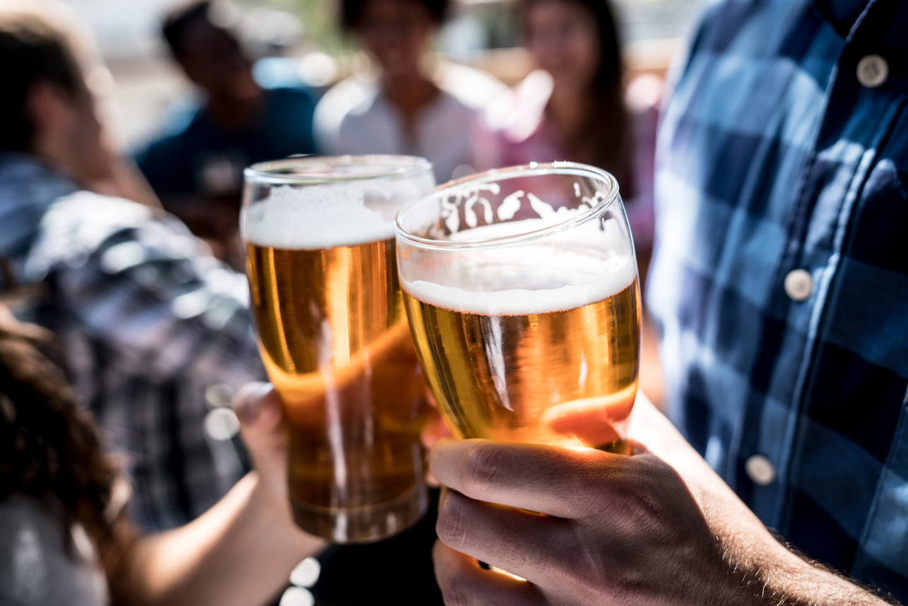
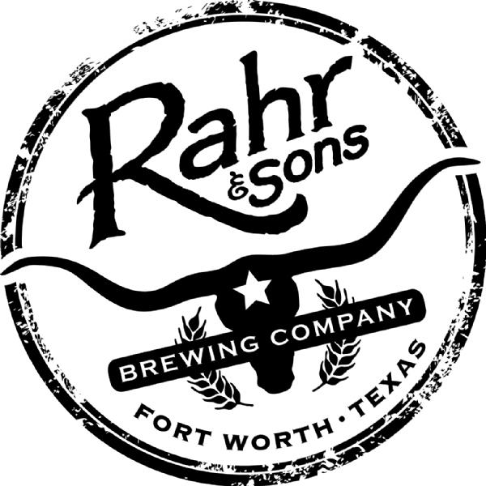
Brew-Forward 2019
Brewpub placement in the Dallas area

Slide 2


Bart Watson
With a strong presence across the 50 states and the District of Columbia, craft breweries are a vibrant and flourishing economic force at the local, state and national level. As consumers continue to demand a wide range of high quality, full-flavored beers, small and independent craft brewers are meeting this growing demand with innovative offerings, creating high levels of economic value in the process.
Why enter this market?
Chief Economist for the Brewers Association

Slide 3

Brew-Forward 2019
With the beer and brewery data you have provided us, we Found the following observations:
Craft breweries by state
State specific beer property metrics
Analysis of a potential relationship between IBU and ABV in beer

Slide 4
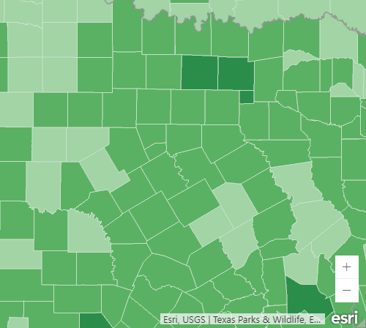
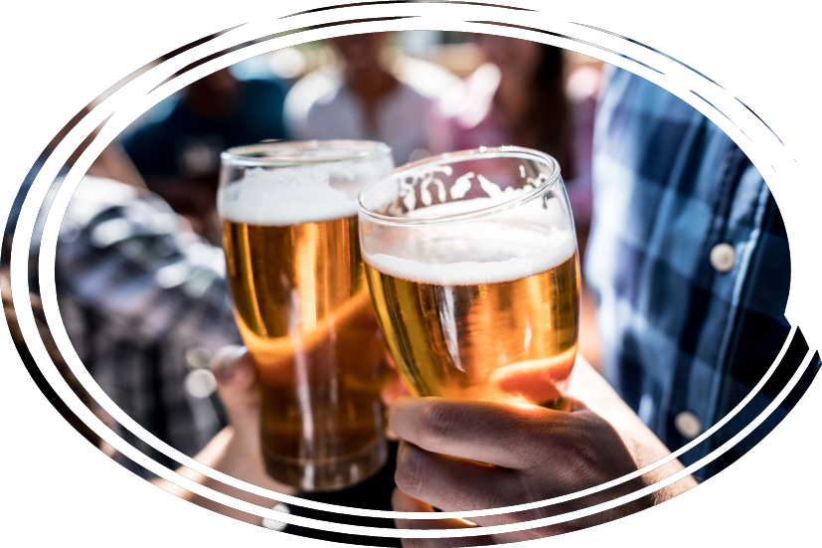
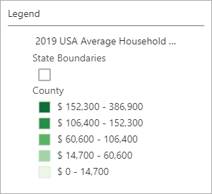
Dallas
Beer records with missing data/NAs
ABV - 62
IBU - 1005

Slide 5
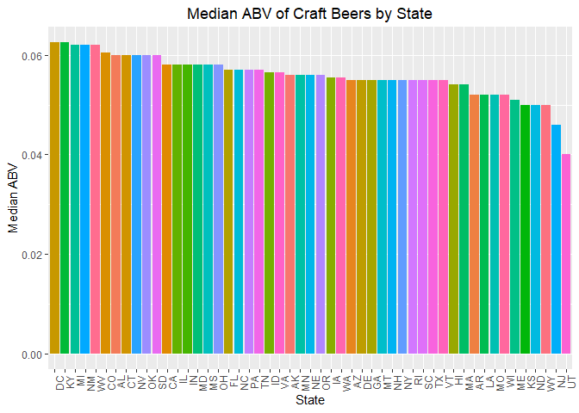
Median ABV By State
The median ABV by states ranges from just above 6% to around 4%.
Most states come in at the upper 5% ABV
If you are looking at entering this market this would be a good safe range to start in.

Slide 6
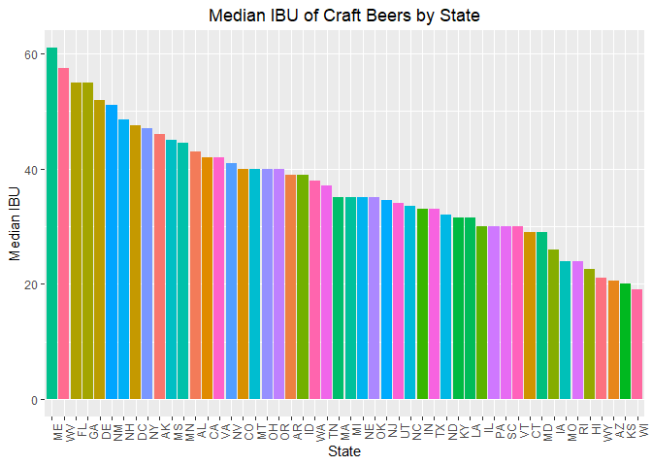
Median IBU by State
The median IBU by states ranges from 4 to just above 60.
This data shows the range of bitterness in beers across America
There are 1005 entries missing in the dataset
Good for general data about the bitterness
You might want to update more records if you are wanting more granular detail

Slide 7
Top beers by state: Colorado produces the beer with the highest ABV Oregon has the most bitter beer (IBU)
State | ABV | Beer Name
CO | 0.128 | Lee Hill Series Vol. 5
KY | 0.125 | London Balling
IN | 0.120 | Csar
State | IBU | Beer Name
OR | 138 | Bitter Bitch
VA | 135 | Troopers Alley
MA | 130 | Dead-Eye DIPA

Slide 8
Top Styles
Style | Count
American IPA | 424
American Pale Ale (APA) | 245
American Amber / Red Ale | 133
American Blonde Ale | 108
American Double / Imperial IPA | 105

Slide 9
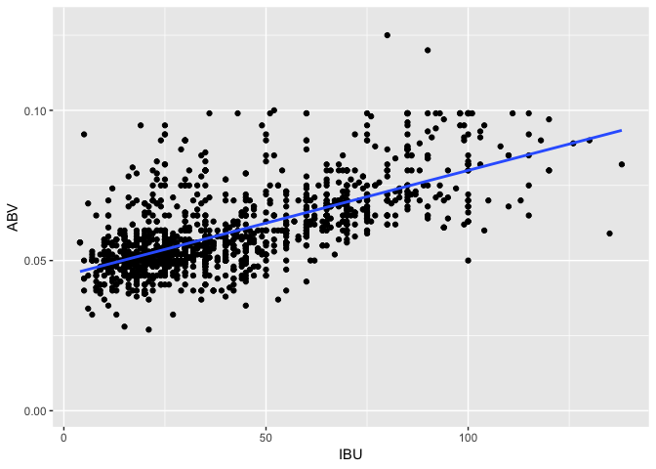
Is there an apparent relationship between the bitterness of the beer and its alcoholic content?
We have found very significant correlation between the alcohol content (ABV) and the bitterness (IBU) of a beer (alpha = .05, r = .67, p < .0001). One thing to keep in mind, there are 62 missing entries in AVB and 1005 in the IBU data leading to a lower degrees of freedom, but at a thousand in the current data set the correlation data is still relevant. This is observational data so even with the correlation, any inferences about causal relationship between alcohol content and bitterness is speculative, but the trend is compelling.

Slide 10
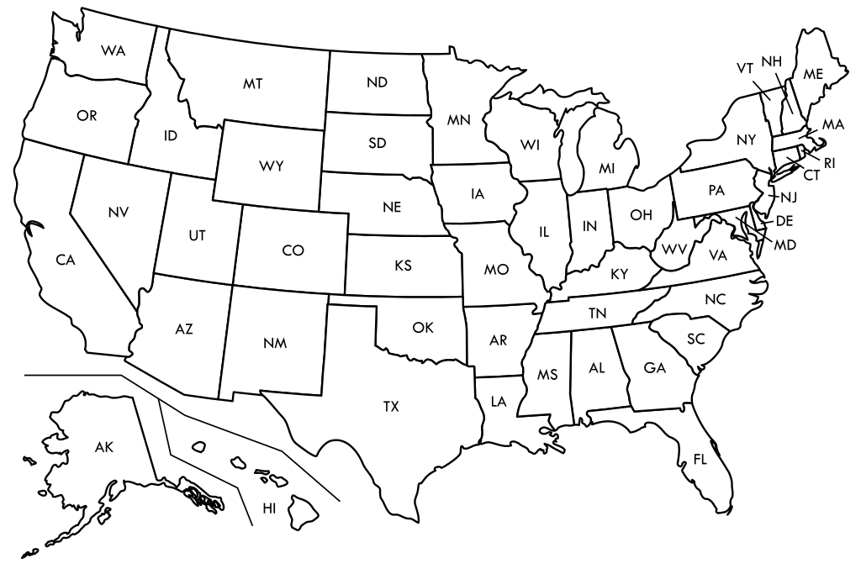
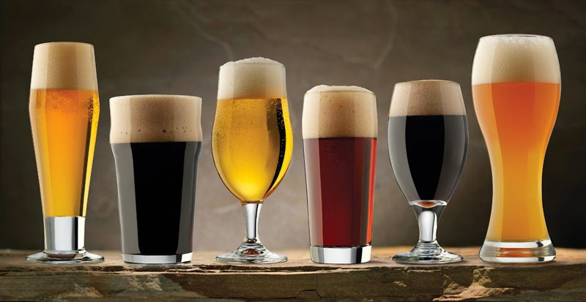

Solutions
We recommend looking at states like Minnesota, Arizona, Vermont, Maine, and Missouri to begin.
IPA’s and Pale Ales are great starting points in styles.
You may need to get more IBU values from the beers you have in the data.
Location
Styles
IBU Data
Look at states that are not saturated with breweries but with an established beer presence.
IPA’s and Pale Ales would be a great starting point in style. Both are the top selection in the US.
Missing data may need to be updated if you plan on looking at the in more detail.

Slide 11




Thank You
Chris Ballenger & Chad Madding
+1 555-0100
chris@rahrbrewing.com
rahrbrewing.com

